Slide 1


Lauretta Ngere
April 29, 2023

Slide 2

Outline
Executive Summary
Introduction
Methodology
Results
Conclusion

Slide 3
Executive Summary
Summary of methodologies
Data Collection and Wrangling
Exploratory Data Analysis and Visual Analysis Method
Exploratory Data Analysis with visualization
Exploratory Data Analysis with SQL
Interactive map with Folium
Dashboard with Plotly
Predictive Analysis

Slide 4
Executive Summary
Summary of all results
Results from Exploratory Data Analysis
Interactive Analytics
Results from Predictive Analysis

Slide 5
Introduction
Project background
SpaceX is the most successful company of the commercial space age, making space travel affordable. The company advertises Falcon 9 rocket launches on its website, with a cost of 62 million dollars: other providers cost upward of 165 million dollars each, much of the savings is because SpaceX can reuse the first stage. Therefore, if we can determine if the first stage will land, we can determine the cost of a launch. Based on public information and machine learning models, we are going to predict if SpaceX will reuse the first stage.
Questions
- Do variables such as Payload mass, Launch site, Number of flights, and orbits affect the success of the first stage landing?
- How is the rate of successful landings over the years?
- What is the best algorithm to be used for binary classification?

Slide 6

Section 1

Slide 7
Data Collection
Data for this project was collected using two methods :
- Using SpaceX Rest API
- Web Scraping from Wikipedia
Data retrieved using both methods contained the following columns: FlightNumber, Data, BoosterVersion, PayloadMass, Orbit, LaunchSite, Outcome, Flights, GridFins, Reused, Legs, LandingPad, Block, ReusedCount, Serial, Longitude, latitude, Flight No., Launch Site, Payload, Customer, Launch Outcome, Versioin Booster, Booster Landing and Time

Slide 8
Data Collection – SpaceX API
Import the required libraries and define auxiliary functions
Define helper functions to extract information using ID numbers in the launch data
Use static response object to make JSON results more consistent
Decode the response content as a Json using .json and turn it into a Pandas dataframe
Construct dataset by combinining columns into a dictionary
Request rocket launch data from SpaceX API using URL

Slide 9
Data Collection – Web Scraping
Import required packages and helper functions
Request the Falcon9 Launch Wiki page from its URL
Extract all column/variable names from the HTML table header
Create a dataframe by parsing the launch HTML tables
Export data to a CSV

Slide 10
Data Wrangling
Dataframe was filtered to only include Falcon 9 launches
Rows with missing values were identified
The mean of the PayloadMass column was calculated
Calculated mean was inserted into the cells with missing values
Further analysis were conducted on the dataset to extract information on launches and orbit types

Slide 11
Import
Import libraries and define auxiliary functions. Then load the SpaceX dataset
Identify and calculate
Identify and calculate the percentage of missing values in each attribute
Identify type
Identify which columns are numerical and categorical
Analyze
Calculate the number of launches on each site and the number and occurrence of each orbit.
Analyze
Create
Create a landing outcome label from Outcome column
Calculate the number and occurrence of mission outcome of the orbits
Data Wrangling

Slide 12
EDA with Data Visualization
Scatter plots, Bar charts and Line charts were created for effective visualization of the dataset.
Scatterplots were used to show relationships between the variables
Bar charts were used to show comparisons among discreet categories
Line charts show trends in data over time

Slide 13
EDA with SQL
SQL queries were performed on the dataset to :
Display the names of the unique launch sites in the space mission
Display 5 records where launch sites begin with the string ‘CCA’
Display the total payload mass carried by boosters launched by NASA (CRS)
Display average payload mass carried by booster version F9 v 1.1
List the date when the first successful landing outcome in ground pad was achieved
List the names of the boosters which have success in drone ship and have payload mass greater than 4000 but less than 6000
List the total number of successful and failure mission launches
List the names of the booster_versions which have carried the maximum payload mass
List the records which will display the month names, failure landing_outcomes in drone ship, booster versions, launch_site for the months in year 2015
Rank the count of successful landing_outcomes between the date 04-06-2010 and 20-03-2017 in descending order
https://github.com/LaurettaNg/IBM-project/blob/main/EDA%20with%20SQL.ipynb

Slide 14
Build an Interactive Map with Folium
Markers were added for all Launch sites, launch outcomes for each launch site and distances between a Launch site and its proximities
Markers with circle, popup label and text label of NASA Johnson Space center were added
Colored markers were used to identify success and failuires
Colored lines were added to show the distance between launch sites and proximities such as highway, coastline and railway
https://github.com/LaurettaNg/IBM-project/blob/main/Visual%20Analysis%20with%20Folium.ipynb

Slide 15
Build a Dashboard with Plotly Dash
Pie charts, Slider and Scatter charts were used to create a dashboard
Dropdown list was included to enable selection of launch site
Pie chart shows success launches for all sites
Slider was added for Payload Mass range
Scatter Chart was used to show the correlation between Payload and Launch success
https://github.com/LaurettaNg/IBM-project/blob/main/spacex_dash_app.py

Slide 16
Predictive Analysis (Classification)
Created a Numpy array from the column ‘Class’ in the data
Standardized the data with StandardScaler
Applied GridSearchCV on LogReg, SVM, Decision Tree and KNN models
Calcultaed the accuracy on the test data using the method.score() for all models
Examined the confusion matrix for all the models
Created a GridSearchCV object with cv=10 to find the best parameters
Split the data into training and testing sets with the train_test_split function
Using the Jaccard_score and F1_score metrics to find the method that performed best

Slide 17
Results
Exploratory data analysis results
Interactive analytics demo in screenshots
Predictive analysis results

Slide 18

Section 2

Slide 19
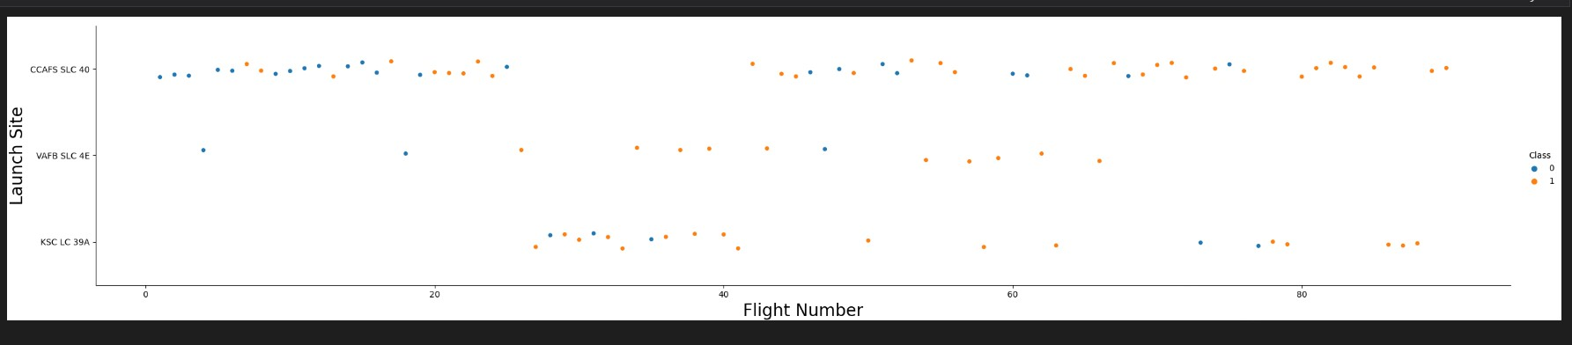
Flight Number vs. Launch Site
The earliest flights failed while the latest flights succeeded
The CCAFS SLC 40 launch site has about 50% of all launches
Each launch has a higher success rate than the previous

Slide 20
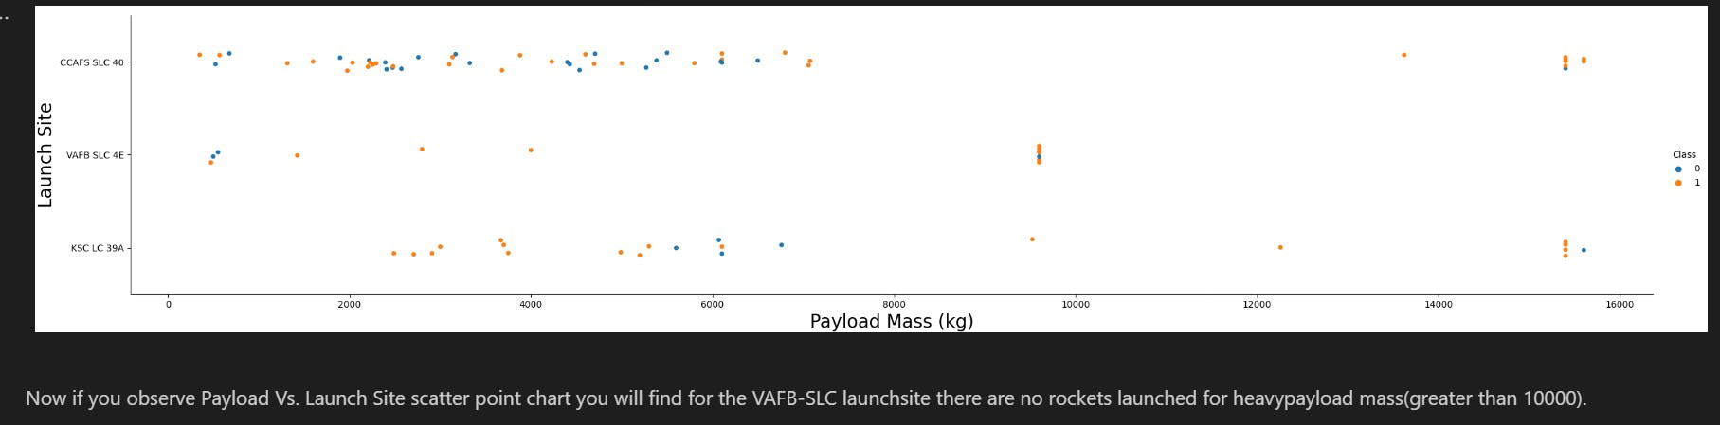
Payload vs. Launch Site

Slide 21
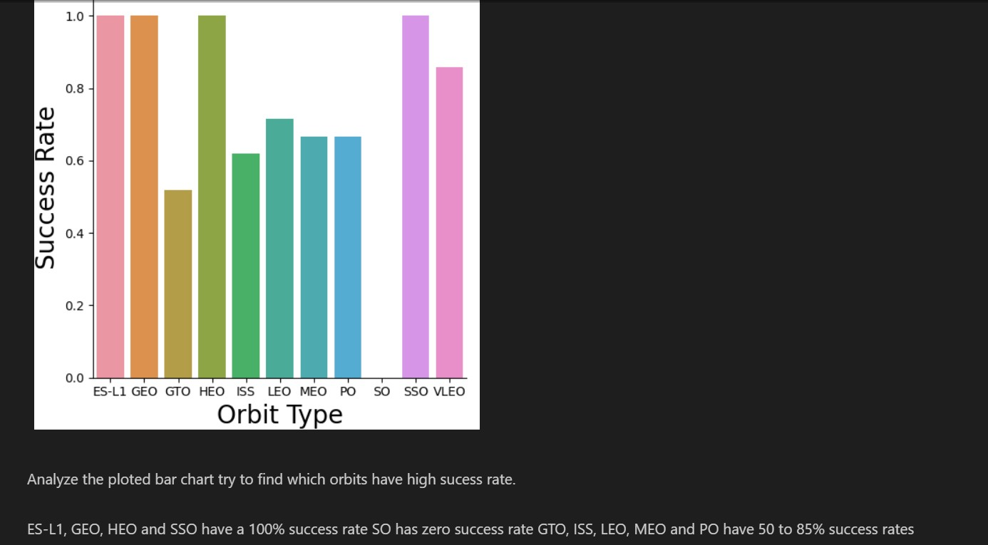
Success Rate vs. Orbit Type

Slide 22
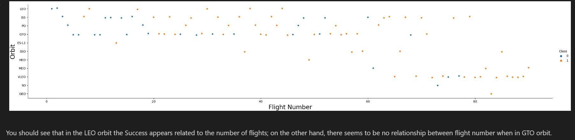
Flight Number vs. Orbit Type

Slide 23
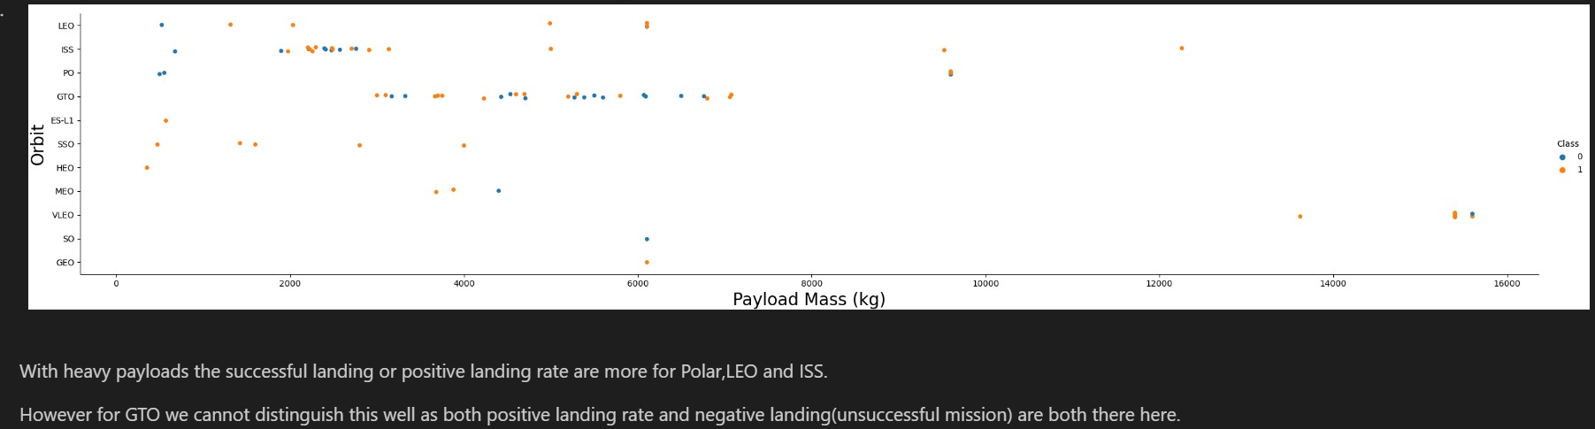
Payload vs. Orbit Type

Slide 24
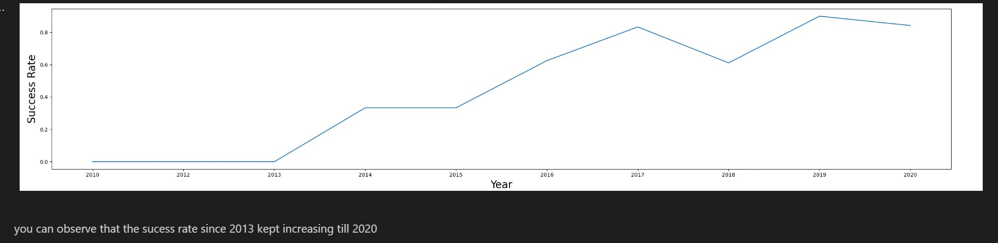
Launch Success Yearly Trend

Slide 25
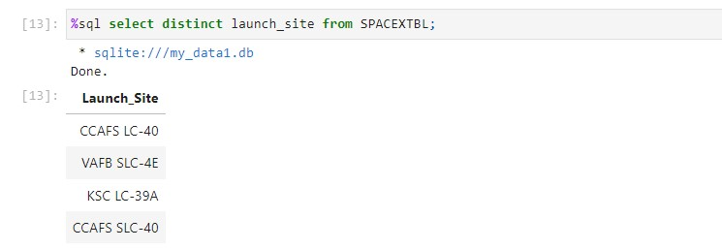
All Launch Site Names

Slide 26
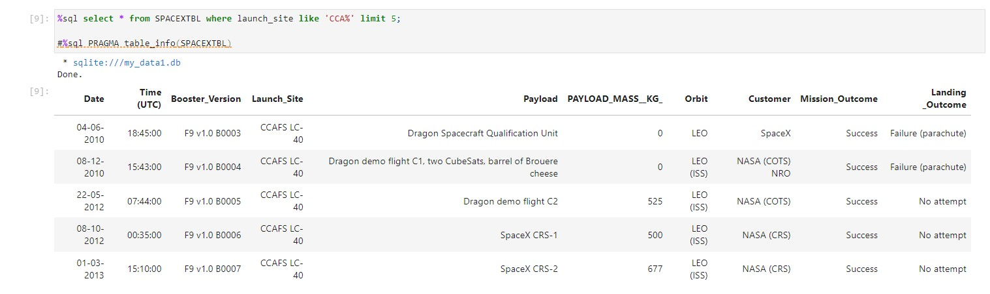
Launch Site Names Begin with 'CCA'

Slide 27
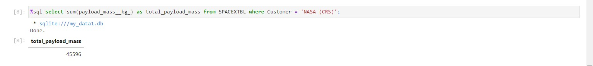
Total Payload Mass

Slide 28
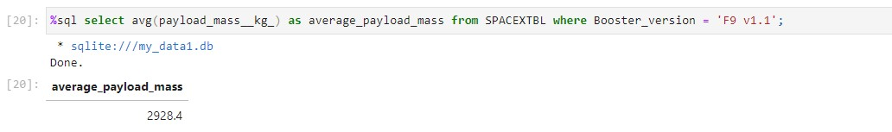
Average Payload Mass by F9 v1.1

Slide 29
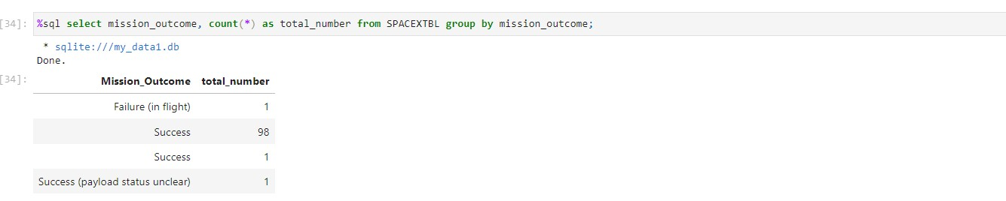
Total Number of Successful and Failure Mission Outcomes

Slide 30
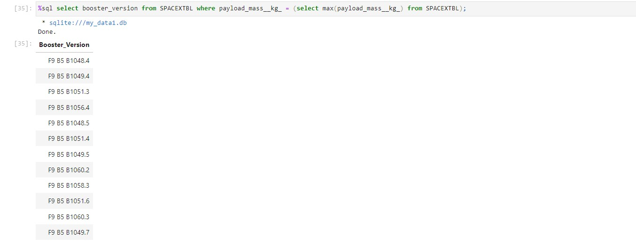
Boosters Carried Maximum Payload

Slide 31

Section 3

Slide 32
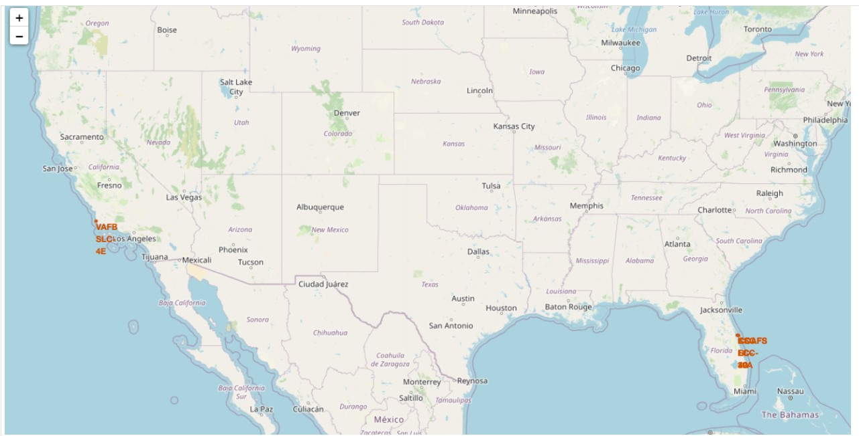
All launch sites global map markers

Slide 33
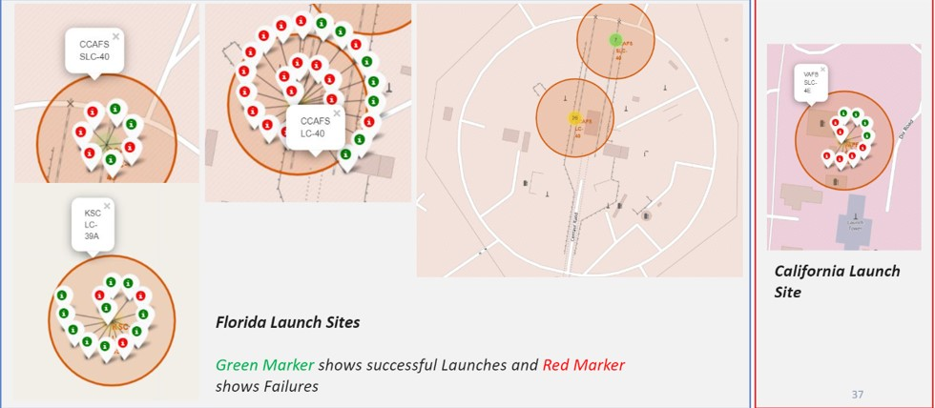
Markers showing launch sites with color labels

Slide 34
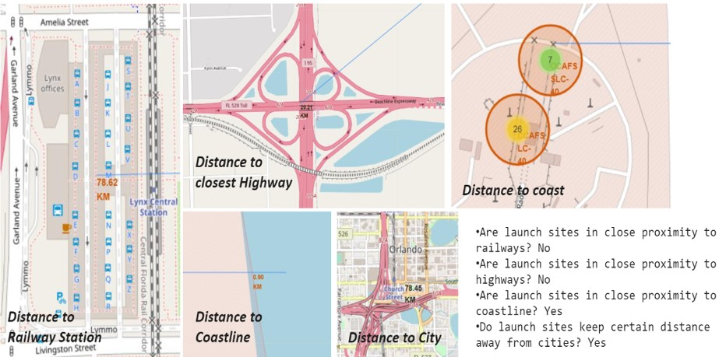
Launch Site distance to landmarks

Slide 35

Section 4

Slide 36
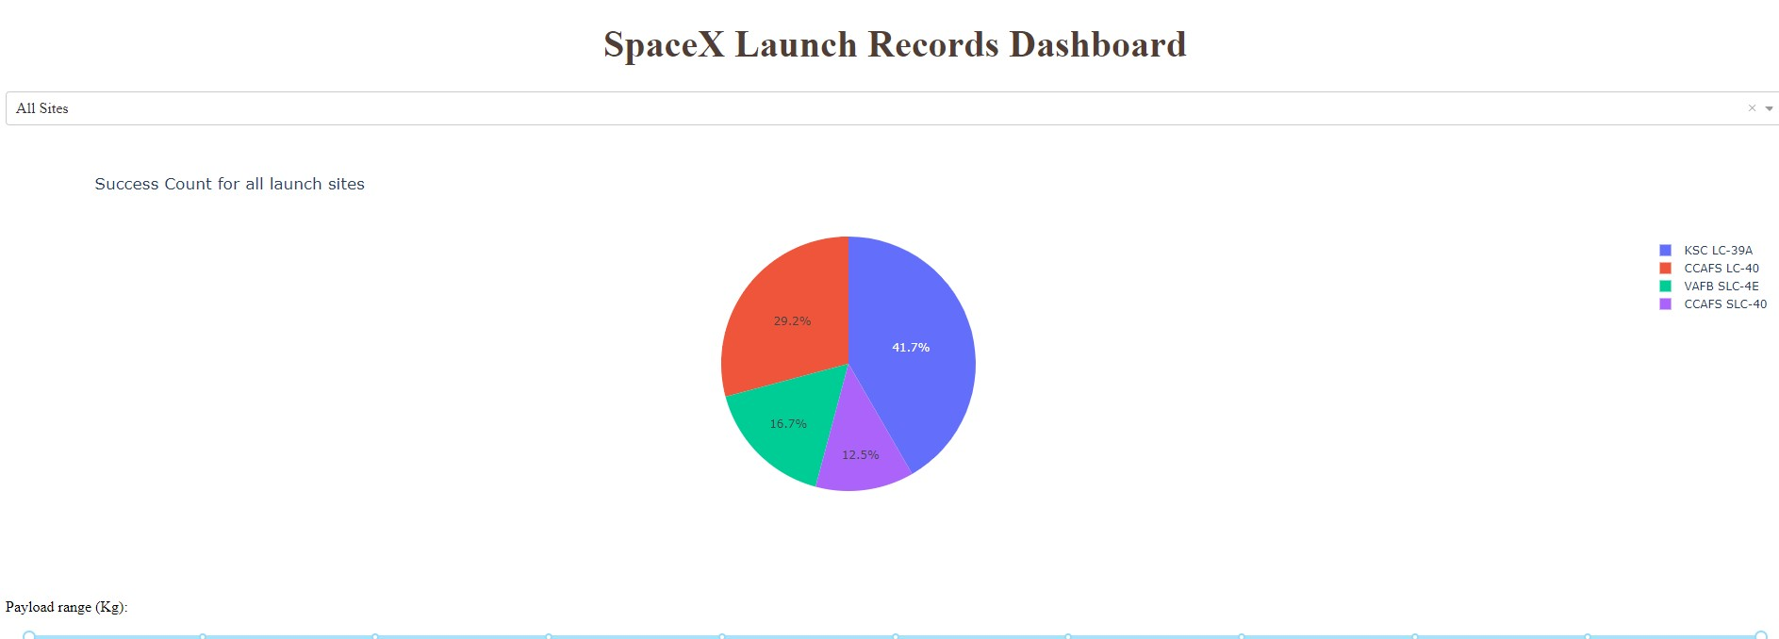
Pie chart of success percentage by each launch site

Slide 37
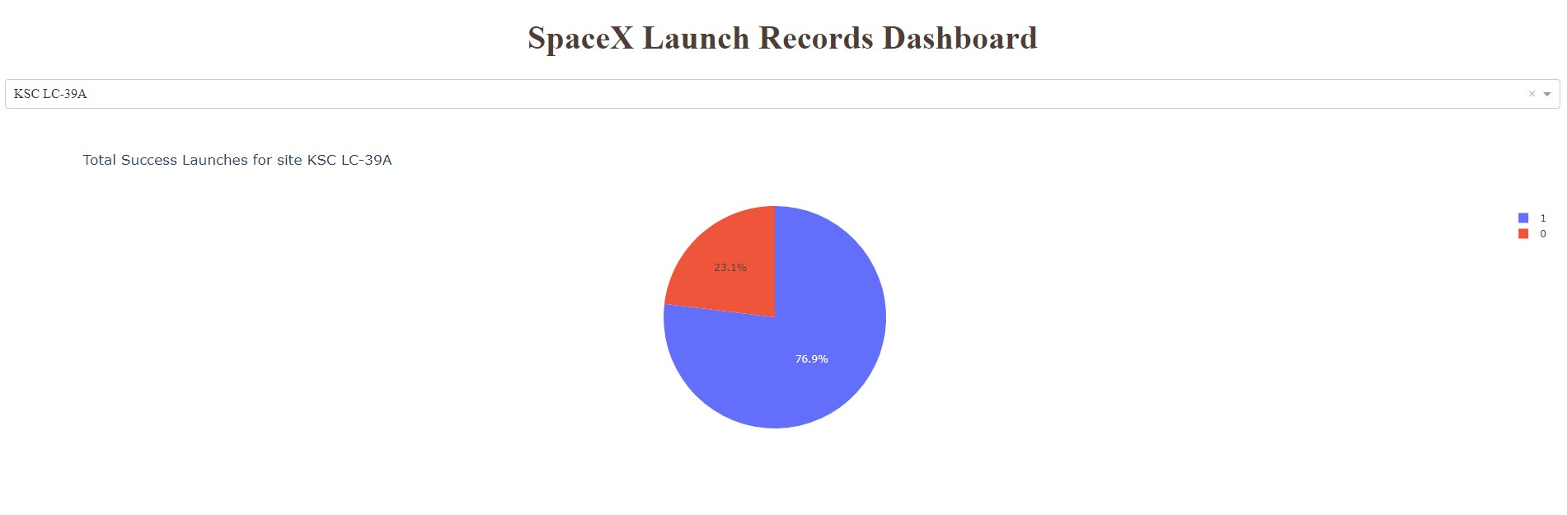
Launch site with the highest launch success ratio

Slide 38
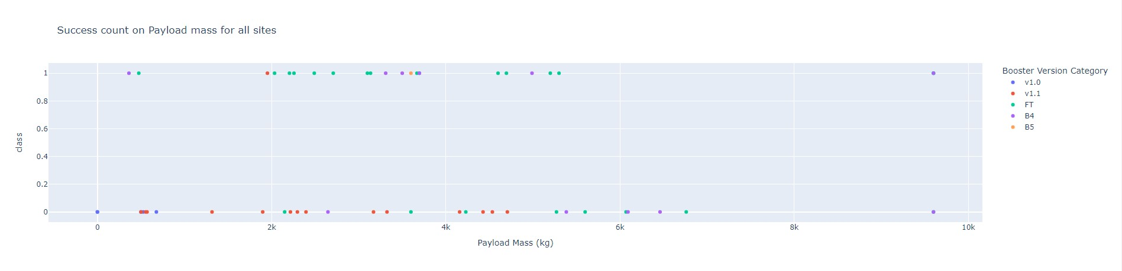
Payload vs Launch Outcome

Slide 39

Section 5

Slide 40
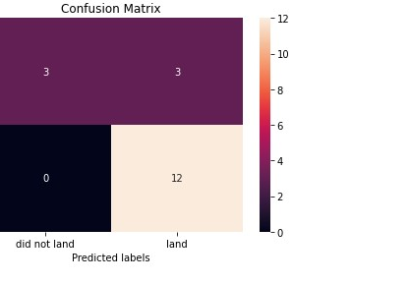
Confusion Matrix

Slide 41
Conclusions
The larger the flight amount at a launch site, the greater the success rate at a launch site
Launch success rate started to increase in 2013 till 2020
Orbits ES-L1, GEO, HEO, SSO, VLEO had the most success rate
KSC LC-39A had the most successful launches of any sites

Slide 42


